Slide 1


Jananjoy Rajkumar
13 December, 2021

Slide 2

Outline on the Presentation
Executive Summary
Introduction
Methodology
Results
Conclusion
Appendix

Slide 3
Executive Summary
Summary of methodologies
Collect data using REST API and results are viewed by calling json() method and perform data wrangling for Exploratory Data Analysis (EDA) .
Perform EDA loading the Spacex dataset into a Db2 database and visualize the attributes relationship using the Matplotlib library.
Build machine learning pipeline (Predictive analysis) for Falcon 9 lands consisting of Preprocessing allowing to standardize our data.
Summary of all results
Perform EDA with visualization understand the relationship patterns, launch site information, success rate of the orbit, Launch success yearly trend.
EDA with SQL provides information about launch sites, payloads information , successful landing outcome, name of the boosters, success and failure outcome, booster version, failed landing outcome and count of landing outcomes.
Interactive map with Folium mark all launch sites, success/failed launches for each site on a map. Besides, calculate the distances between a launch site to its proximities.
Predictive analysis find the best Hyperparameters for SVM, Classification Tress and Logistics Regression.

Slide 4
Introduction
Project background
Commercial companies are working on many space projects. Such type of projects are expensive because of the complexity and infrastructures. However, Spacex is one of the successful project in this domain.
Context
Many commercial companies are interested to execute on space projects. However, efficient optimization is an important aspect because of the infrastructures, complexity, and cost. We need to perform systematic analysis to understand the root cause of the problem
Problems you want to find answers
Want to build a machine learning model using the available spacex dataset for optimizing the system. Taking the role of data scientist, I want to gather the data from spacex and create a dashboard for the team members which helps to predict the reusability of the resources.

Slide 5


Slide 6
Methodology
Executive Summary
Data collection methodology:
Data are collected using the REST API with exposed endpoints
Use the Spacex dataset in .CSV loading to the DB2 databases
Perform data wrangling
Use attributes specific to the exploratory data analysis (EDA) requirements
Perform exploratory data analysis (EDA) using visualization and SQL
Use SQL statement
Perform interactive visual analytics using Folium and Plotly Dash
Use Matplotlib library
Perform predictive analysis using classification models
Build machine learning pipeline (Predictive analysis) model

Slide 7
Data Collection
Data are collected using the REST API with exposed endpoints.
Start
url = “https://api.spacexdata.com/v4//launches/past”
response =requests.get(url)
Data= pd.json_normalize(response.json())
Stop

Slide 8
Data Collection – SpaceX API
Start
Import the Libraries and define the function
Request and Parse the data
Filter the dataframe
Import Libraries and Define Auxiliary Functions
Request and parse data using the GET request
Filter the dataframe
GitHub URL: https://github.com/jananjoy/Applied-data-science-capstone/blob/main/JR_data-collection-api(Week-1).ipynb
Stop

Slide 9
Data Collection - Scraping
Start
Extract a Falcon 9 launch records HTML table from Wikipedia*
Parse the table and convert it into a Pandas data frame
Request the Falcon9 Launch Wiki page from its URL
Extract all column/variable names from the HTML table header
Create a data frame by parsing the launch HTML tables
GitHub url: https://github.com/jananjoy/Applied-data-science-capstone/blob/main/JR_webscraping(Week-1).ipynb
Stop
9

Slide 10
Data Wrangling
Start
Wrangling data with API
Sampling Data
Dealing with Nulls
Dealing with Missing Values
Stop
GitHub URL:-https://github.com/jananjoy/Applied-data-science-capstone/blob/main/JR_data_wrangling(Week-1).ipynb
10
10

Slide 11
EDA with Data Visualization
Perform exploratory Data Analysis and Feature Engineering using `Pandas` and `Matplotlib`
Exploratory Data Analysis
Preparing Data Feature Engineering
Lists of the tasks perform with data visualization are as follows:
Visualize the relationship between Flight Number and Launch Site`
Visualize the relationship between Flight Number and Launch Site
Visualize the relationship between success rate of each orbit type
Visualize the relationship between Flight Number and Orbit type
Visualize the relationship between Payload and Orbit type
Visualize the launch success yearly trend
Create dummy variables to categorical columns
Cast all numeric columns to `float64`
GitHub URL:- https://hub.gke2.mybinder.org/user/ipython-ipython-in-depth-r5j2z0la/notebooks/binder/Index.ipynb#

Slide 12
EDA with SQL
Display the names of the unique launch sites in the space mission
Display 5 records where launch sites begin with the string 'CCA’
Display the total payload mass carried by boosters launched by NASA (CRS)
Display average payload mass carried by booster version F9 v1.1
List the date when the first successful landing outcome in ground pad was acheived. Using bullet point format, summarize the SQL queries you performed
List the names of the boosters which have success in drone ship and have payload mass greater than 4000 but less than 6000
List the total number of successful and failure mission outcomes
List the names of the booster_versions which have carried the maximum payload mass. Use a subquery
List the failed landing_outcomes in drone ship, their booster versions, and launch site names for in year 2015
Rank the count of landing outcomes (such as Failure (drone ship) or Success (ground pad)) between the date 2010-06-04 and 2017-03-20, in descending order
GitHub URL:-https://github.com/jananjoy/Applied-data-science-capstone/blob/main/My_EDA_with_SQL(Week-2).ipynb

Slide 13
Build an Interactive Map with Folium
The generated map with marked launch sites which include Cceating `folium.Circle` and `folium.Marker` for each launch site on the site map.
Mark the success/failed launches for each site on the map
Calculate the distances between a launch site to its proximities
Use `folium.Circle` to add a highlighted circle area with a text label on a specific coordinate and folium.Marker for plotting markers on a map
GitHub URL :- https://github.com/jananjoy/Applied-data-science-capstone/blob/main/JR_Interactive%20Visual%20Analytics%20with%20Folium%20lab(Week-3).ipynb

Slide 14
Build a Dashboard with Plotly Dash
Dashboard application contains input components such as a dropdown list and a range slider to interact with a pie chart and a scatter point chart. Lists of the tasks involved are :
Add a Launch Site Drop-down Input Component
Add a callback function to render success-pie-chart based on selected site dropdown
Add a Range Slider to Select Payload
Add a callback function to render the success-payload-scatter-chart scatter plot
Note:- Since my lab environment is not working. I kept the screeshot from the lab instruction.
At the same time, I refer my answer with reference to the mentioned screenshot. During the course I already executed the code.
GitHub URL:

Slide 15
Predictive Analysis (Classification)
Perform exploratory Data Analysis and determine Training Labels
Create a column for the class
Standardize the data
Split into training data and test data
Find best Hyperparameter for SVM, Classification Trees and Logistic Regression
Find the method performs best using test data
GitHub URL:-https://github.com/jananjoy/Applied-data-science-capstone/blob/main/JR_ML_prediction(Week-4).ipynb

Slide 16
Results
Perform Exploratory Data Analysis and Preparing Data Feature Engineering. We find the co-relation between the attributes. For example, We see that different launch sites have different success rates from the results. Again, from observe Payload Vs. Launch Site scatter point chart you will find for the VAFB-SLC launch site there are no rockets launched for heavypayload mass(greater than 10000).
Find best Hyperparameter for Support Vector Machine (SVM), Classification Trees and Logistic Regression. We found different accuracy values (share in the previous slide). Classification Trees provides better accuracy.
In Interactive analytics demo, first, Mark all launch sites on a map. Then, Mark the success/failed launches for each site on the map. Finally, Mark the success/failed launches for each site on the map. (Screenshot is presented in the slide also).

Slide 17


Slide 18
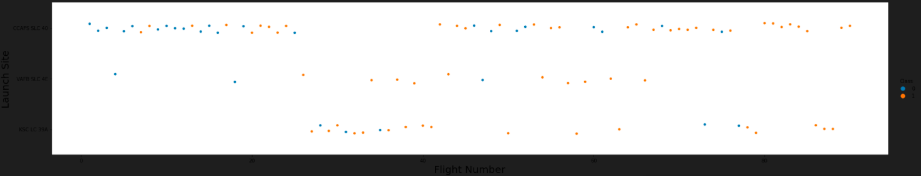
Flight Number vs. Launch Site
Explain the relationship between the attributes Flight Number and Launch site

Slide 19
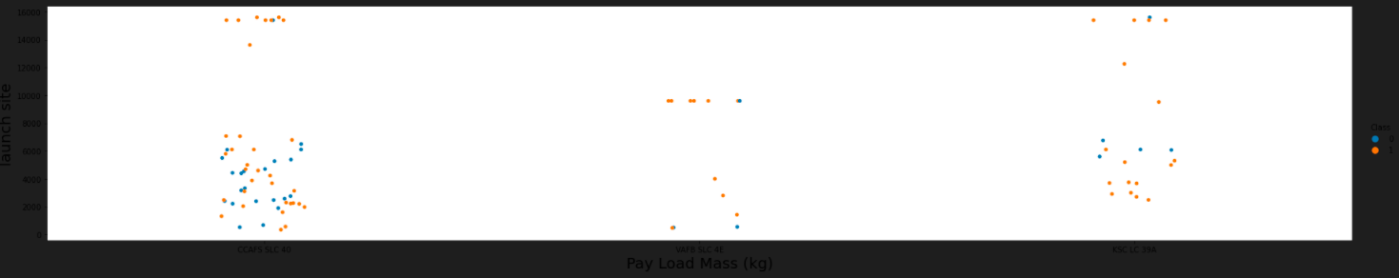
Payload vs. Launch Site
Explain the relationship between the attributes payload and Launch site

Slide 20
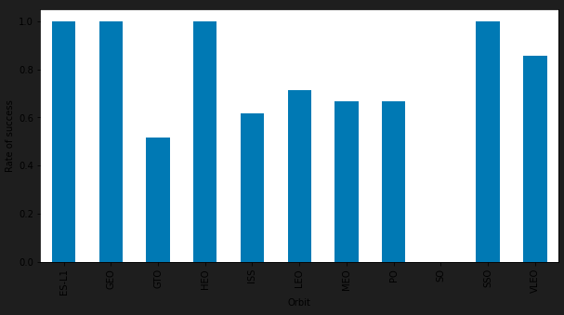
Success Rate vs. Orbit Type
Show the screenshot of the scatter plot with explanations

Slide 21
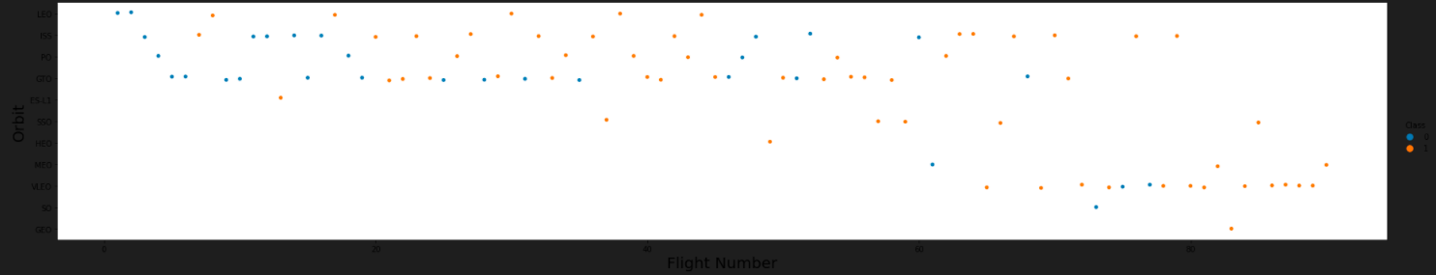
Flight Number vs. Orbit Type
Explain the relationship between the attributes Flight Number and Orbit Type

Slide 22
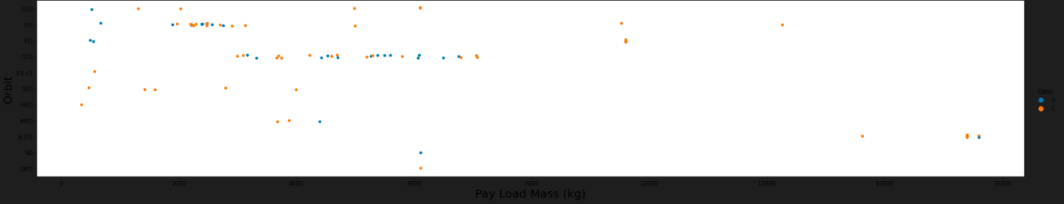
Payload vs. Orbit Type
Explain the relationship between the attributes Payload and Orbit Type

Slide 23
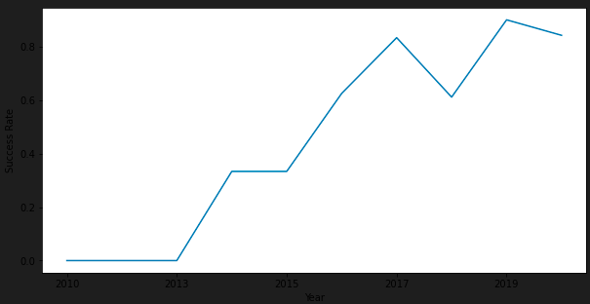
Launch Success Yearly Trend
Explain the launch success yearly Trend based on the historical data in the data source

Slide 24
All Launch Site Names
Find the names of the unique launch sites
Present your query result with a short explanation here

Slide 25
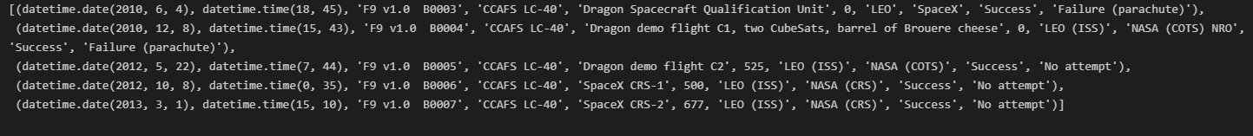
Launch Site Names Begin with 'CCA'
Find 5 records where launch sites begin with `CCA`
The query displays the launch sites started with the string CCA

Slide 26
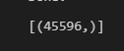
Total Payload Mass
Calculate the total payload carried by boosters from NASA
The above query display the total payload carried by boosters from NASA

Slide 27
Average Payload Mass by F9 v1.1
Calculate the average payload mass carried by booster version F9 v1.1
The above query calculate the average payload mass carried by booster version F9 v1.1

Slide 28
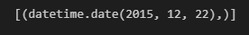
First Successful Ground Landing Date
Find the dates of the first successful landing outcome on ground pad
The above query find and return the date of the first successful landing outcome on ground pad

Slide 29
Successful Drone Ship Landing with Payload between 4000 and 6000
List the names of boosters which have successfully landed on drone ship and had payload mass greater than 4000 but less than 6000
The above query returns the names of the boosters meeting the condition

Slide 30
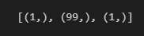
Total Number of Successful and Failure Mission Outcomes
Calculate the total number of successful and failure mission outcomes
The above query calculate the total number of successful and failure mission outcomes

Slide 31
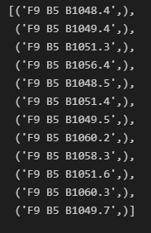
Boosters Carried Maximum Payload
List the names of the booster which have carried the maximum payload mass
The above query lists the of the booster which have carried the maximum payload mass

Slide 32
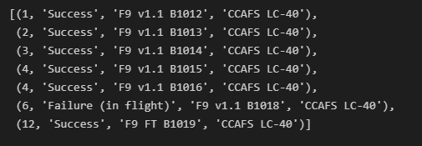
2015 Launch Records
List the failed landing_outcomes in drone ship, their booster versions, and launch site names for in year 2015
Present your query result with a short explanation here

Slide 33
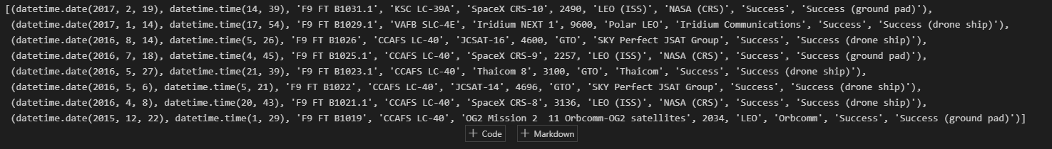
Rank Landing Outcomes Between 2010-06-04 and 2017-03-20
Rank the count of landing outcomes (such as Failure (drone ship) or Success (ground pad)) between the date 2010-06-04 and 2017-03-20, in descending order
The above query rank the count of the landing outcomes meeting the specify condition

Slide 34


Slide 35
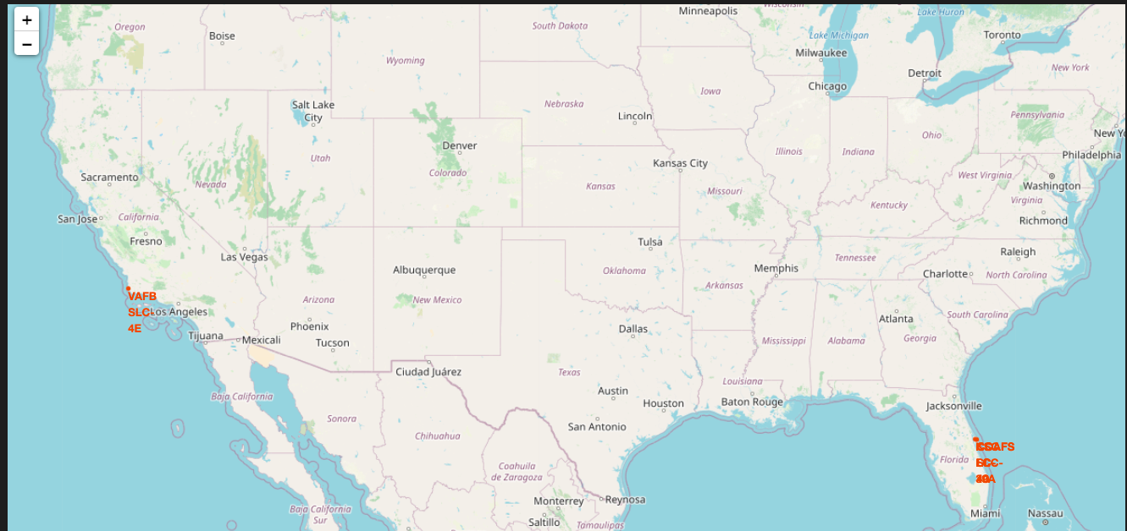
Mark all launch site on the map
The above picture displays all the launch site on the map

Slide 36
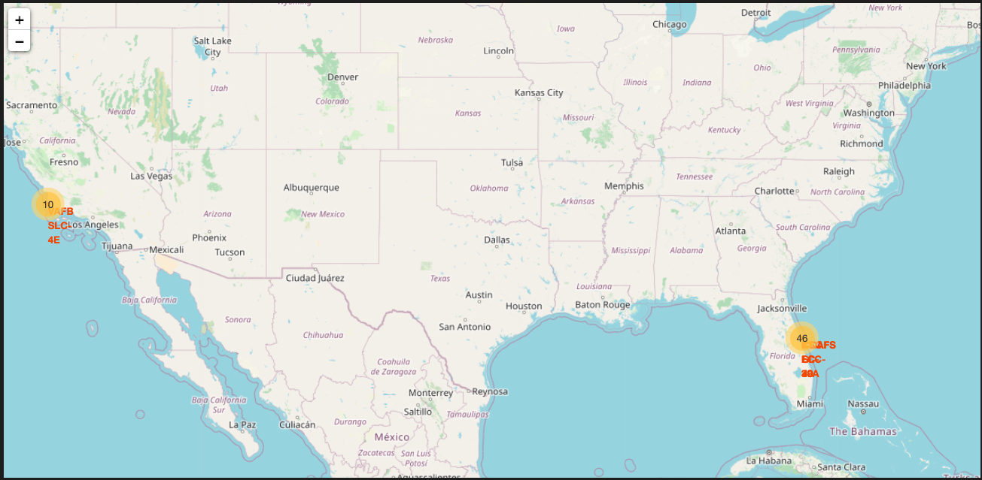
Mark success/failure launches for each site on the map
The above picture mark success/failure launches for each site on the map

Slide 37
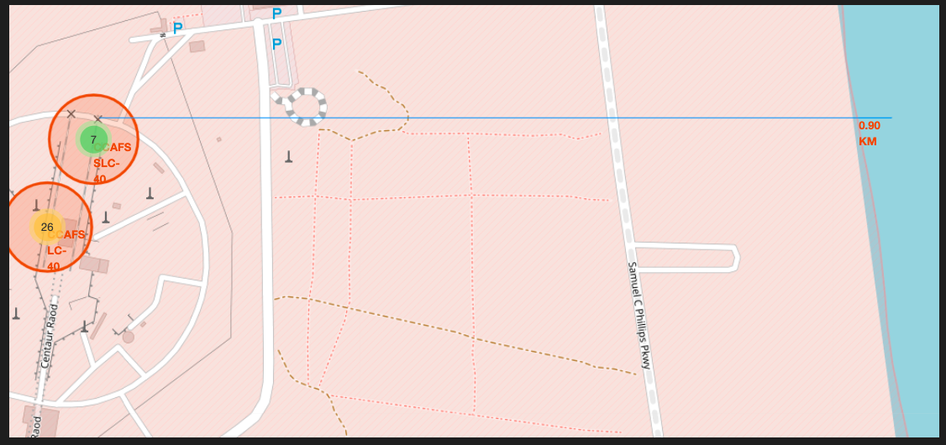
Calculate the distance between launch site to its proximities
The above picture calculate the distance between launch site to its proximities

Slide 38


Slide 39
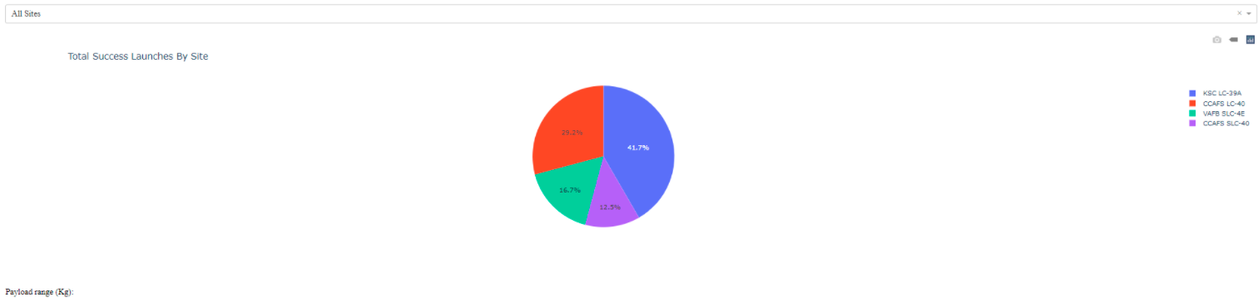
Launch success Dashboard
Note:- Since my lab environment is not working. I kept the screeshot from the lab instruction.
At the same time, I refer my answer with reference to the mentioned screenshot. During the course I already executed the code.
The Screenshot provide the information about the largest successful launches and the highest launch success rate .

Slide 40
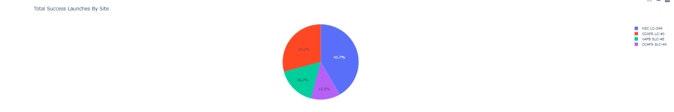
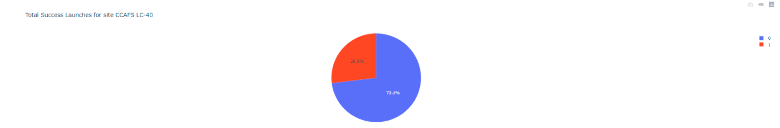
Launch site with highest launch success ratio
Note:- Since my lab environment is not working. I kept the screeshot from the lab instruction.
At the same time, I refer my answer with reference to the mentioned screenshot. During the course I already executed the code.
These screenshot provide information of the success ratio for all the site and for specific launch site.

Slide 41
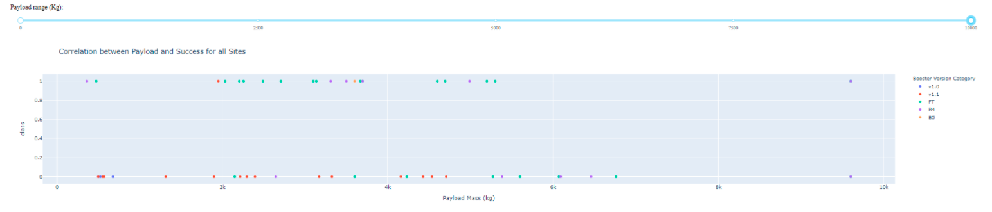
Payload vs. Launch Outcome scatter plot for all sites
Note:- Since my lab environment is not working. I kept the screeshot from the lab instruction.
At the same time, I refer my answer with reference to the mentioned screenshot. During the course I already executed the code.
From the screenshot, the following information can be observed such as largest successful launches and highest launch success rate of a site, payload range(s) having highest/lowest launch success rate. Besides, v1.0 F9 Booster version (v1.0, v1.1, FT, B4, B5, etc.) has the highest launch success rate.

Slide 42


Slide 43
Classification Accuracy
Classification tree model has the highest accuracy [accuracy : 0.9017857142857144]

Slide 44
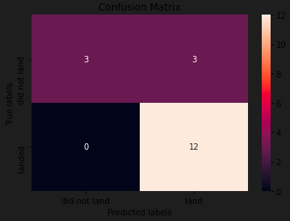
Confusion Matrix
Show the confusion matrix of the best performing model with an explanation

Slide 45
Conclusions
Perform data collection using REST API and data wrangling operation which includes sampling, dealing with nulls (missing data points)
Perform exploratory data analysis and execute SQL query. Besides we plot the data to visualize the result.
Build an interactive dashboard with ploty dash for visual data analytics.
Build a predictive machine learning model and analyze the results with accuracy.

Slide 46
Appendix
Spacex dataset in the .csv format
Virtual Lab environment for running the code
IBM cloud platform for executing, storing and managing the code and documents.
Use the GitHub as repository.
All codes, documents, presentation are available in the repository.

Slide 47


